Slide 1

Lingayas Institute of Management and Technology
Approved by AICTE, Affiliated to JNTU Kakinada, Accredited with A Grade by NAAC and
UG-CSE is accredited by NBA
IV-II Project Viva-voce on
Gitscope AI: A Unified Pre-Commit Intelligence Framework for Multi-Dimensional Repository Risk and Popularity Analytics in GitHub Ecosystems
22NA1A6103 T. Venkat
22NA1A6102 M. Moksha
Under the Guidance of
Guide: Prof A. Rajesh
Co-guide : Prof. Jyothi
Department of Artificial Intelligence and Machine learning

Slide 2
Contents
Abstract
Introduction
Literature Review
Purpose and objectives
Methodology
Results and Discussion
Conclusion
Scope for future work
Acknowledgements
Reference

Slide 3
ABSTRACT
GitScope AI is a web platform that helps developers evaluate GitHub repositories before contributing. It combines four ML-driven modules pre-commit code quality via Pylint, Javac, popularity prediction, defect risk assessment, and bounty aggregation all pulling live data through the GitHub API on a React and Fast API stack.
Five classifiers were trained for popularity prediction, with XGBoost leading at 99.9% test accuracy and 93.5% cross-validation accuracy. Authentication runs through email OTP and GitHub OAuth, and the modular design makes future extensions additional languages, CI/CD hooks, real-time monitoring practical from day one.

Slide 4
INTRODUCTION
GitHub has become the backbone of modern open-source development, hosting millions of repositories that generate rich activity data commits, pull requests, stars, forks, and issues
Despite this wealth of data, developers still lack a reliable way to judge whether a repository is worth contributing to before writing a single line of code
Existing tools are either too shallow, relying on surface metrics like stars and forks, or too slow, depending on manual code review that doesn't scale
Studies on popularity prediction (Bidoki et al., 2018) and defect prediction (Shen et al., 2022) have tackled pieces of this problem but always in isolation

Slide 5
INTRODUCTION cont….
No unified framework currently exists that combines pre-commit code quality analysis with repository risk assessment and popularity prediction in one place
GitScope AI fills this gap a multi-model ML platform that runs four analyses: static code quality via Pylint, Javac, popularity classification, defect risk, and bounty aggregation
All modules operate on live GitHub API data, with results delivered through a single React + Fast API interface
The goal is simple: give developers one platform that turns raw repository data into something they can actually act on before they commit

Slide 6
Literature Review
Objectives | Findings | References
To predict the popularity of GitHub repositories using repository activity data. | The study showed that repository popularity is influenced by cross-repository interactions. LSTM-based models using fork and watch events achieved better prediction accuracy than traditional ARIMA models. | Hajiakhoond Bidoki, N., Sukthankar, G., Keathley, H., & Garibay, I. (2018). A Cross-Repository Model for Predicting Popularity in GitHub. 2018 International Conference on Computational Science and Computational Intelligence (CSCI), 1248–1253.
To design an efficient GitHub-based data collection method for software defect prediction. | The Study framework effectively identified defect-related pull requests and improved dataset quality, resulting in better defect prediction performance. | Xu, J., Yan, L., Wang, F., & Ai, J. (2020). A GitHub-Based Data Collection Method for Software Defect Prediction. 2019 6th International Conference on Dependable Systems and Their Applications (DSA), 100–108.
To examine the role of commit messages in creating datasets for fault prediction. | The study found that bug-related keywords in commit messages can help identify fault-prone classes with reasonable accuracy, supporting large-scale dataset creation. | Caulo, M., & Scanniello, G. (2019). On the Use of Commit Messages to Support the Creation of Datasets for Fault Prediction: An Empirical Assessment. 2019 45th Euromicro Conference on Software Engineering and Advanced Applications (SEAA), 193–198.

Slide 7
Objective | Findings | Reference
To improve software defect prediction accuracy using optimized machine learning techniques. | The study found Bayesian Optimization significantly enhanced Random Forest performance, achieving higher accuracy compared to CNN, LSTM, and SVM models. | Shen, Y., Hu, S., Cai, S., & Chen, M. (2022). Software Defect Prediction based on Bayesian Optimization Random Forest. 2022 9th International Conference on Dependable Systems and Their Applications (DSA).
To analyze the relationship between monetary bounties and issue resolution in GitHub projects. | The study revealed that early bounty proposals significantly increase the likelihood of issue resolution, highlighting the impact of human and economic factors. | Zhou, J., Wang, S., Bezemer, C.-P., Zou, Y., & Hassan, A. E. (2021). Studying the Association Between Bountysource Bounties and the Issue-Addressing Likelihood of GitHub Issue Reports. IEEE Transactions on Software Engineering, 47(12), 2919–2933.
To develop a Multi-Model Machine Learning framework that integrates pre-commit code quality analysis with predictive risk assessment for GitHub repository health. | This study proposes a unified framework GitScope AI that correlates pre-commit code quality metrics with repository-level risk indicators. Unlike prior studies that address these aspects independently, this work integrates static code analysis, popularity prediction, and defect detection into a single predictive health assessment system for GitHub repositories. | This Study

Slide 8
Objectives:
To investigate which repository activity features commit frequency, issue density, and contributor count have the strongest predictive value for classifying repository popularity and defect risk.
To evaluate whether pre-commit static analysis catches quality violations that standard IDE tools miss, and measure how much earlier it surfaces them.
To compare the classification accuracy of ensemble models (Random Forest, XGBoost) against simpler baselines (Logistic Regression, KNN, MLP) on repository-level prediction tasks.
To assess whether combining code quality, popularity, defect risk, and bounty data in one framework gives developers more useful insights than using each tool separately.

Slide 9
Methodology
GitHub Repository Selection
Data Collection from GitHub (Events, Commits, Issues, Bounties)
Data Preprocessing & Feature Extraction
Feature Engineering (Code, Activity, Popularity, Defect Metrics)
Machine Learning Models (Random Forest, XGBoost for Defect Prediction)
Result Visualization & Decision Support

Slide 10
Requirements
Category | Tool / Technology | Why It Was Used
Frontend | React.js, Tailwind CSS, Chart.js, Axios | Builds interactive UI, handles responsive styling, renders graphs, and manages API calls.
Backend | FastAPI, Uvicorn | Handles API endpoints with request validation; Uvicorn runs it as an async ASGI server.
Database | MongoDB | Stores user profiles, session tokens, and analysis history in a flexible NoSQL schema.
ML Libraries | Scikit-learn, XGBoost, NumPy, Pandas | Provides classification models, boosted learning, and feature vector processing.
Code Analysis | Pylint, Javac | Detects Python code issues (docstrings, imports, style) and Java syntax/dependency errors.
Authentication | Email OTP (SMTP), GitHub OAuth 2.0 | Verifies users via OTP; OAuth allows single-click login and auto-fetches repository data.
External API | GitHub REST API | Fetches live stars, forks, issues, commits, and contributor data at request time.
Dev Environment | Visual Studio Code | Used for development and debugging of both frontend and backend servers.
OS Support | Windows 10/11, macOS, Ubuntu 20.04+ | Runs on any OS supporting Python 3.9+, Node.js 16+, and MongoDB.

Slide 11
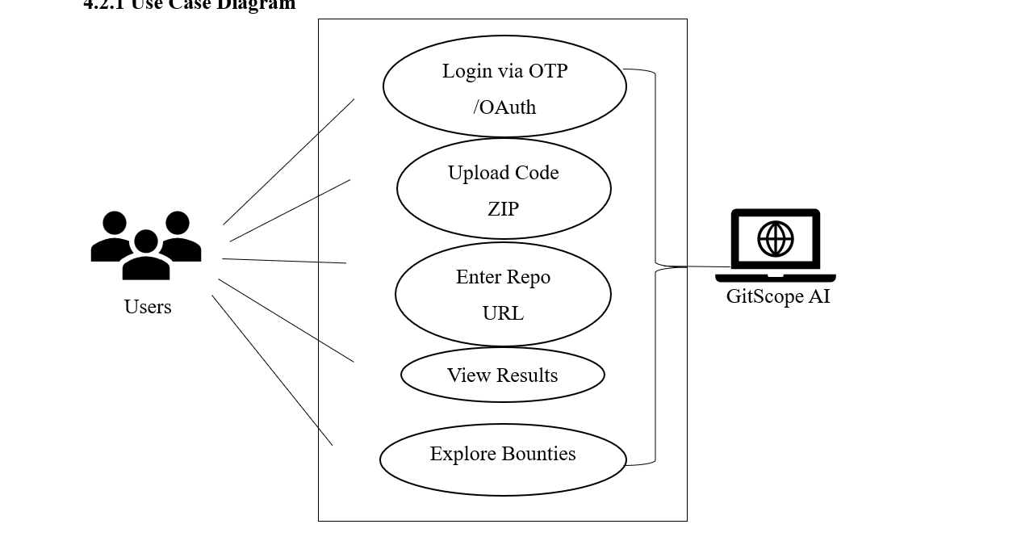
Use Case Diagram
Fig 1: Use Case Diagram
The Fig 1 use case diagram represents the interaction between users and the GitScope AI system. Users can log in, upload code or provide a repository URL, view analysis results, and explore bounty opportunities. It shows how the system processes user inputs to deliver insights on code quality, popularity, and bug risk.

Slide 12
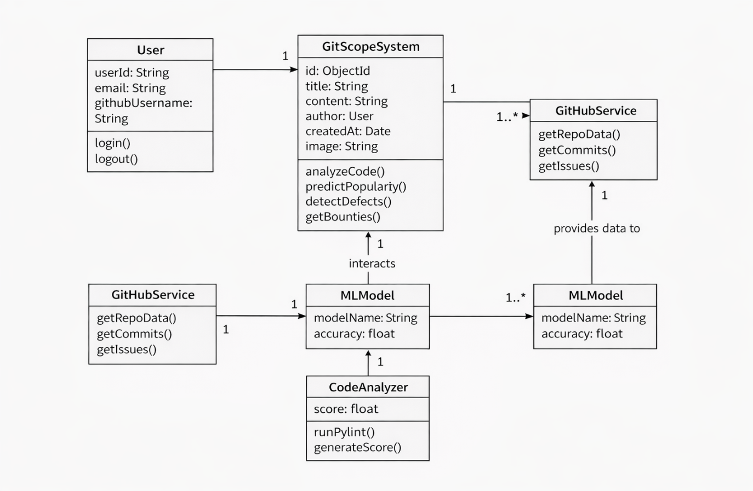
Class Diagram
The Fig 2 represents the structure of the GitScope AI system and the relationships between its components. It includes classes like User, GitScope System, GitHub Service, ML Model, and Code Analyzer, which work together to process data and perform analysis. It shows how user inputs are handled and how different modules interact to generate predictions and results.
Fig 2: Class Diagram

Slide 13
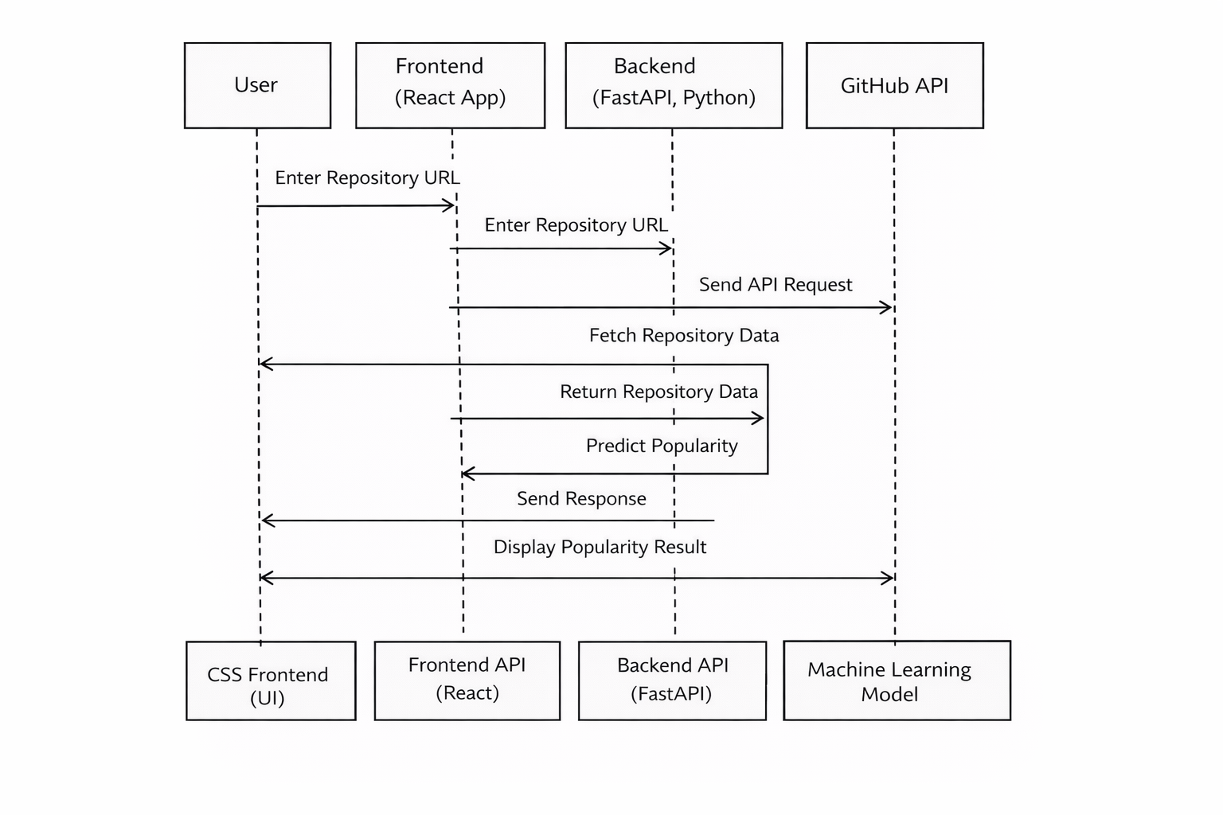
Sequence Diagram
The Fig 3 shows the step-by-step flow of interaction between the user, frontend, backend, and GitHub API. The user enters a repository URL, the frontend sends the request to the backend, which fetches data from the GitHub API and processes it using the machine learning model. Finally, the results are sent back and displayed to the user.
Fig 3: Sequence Diagram

Slide 14
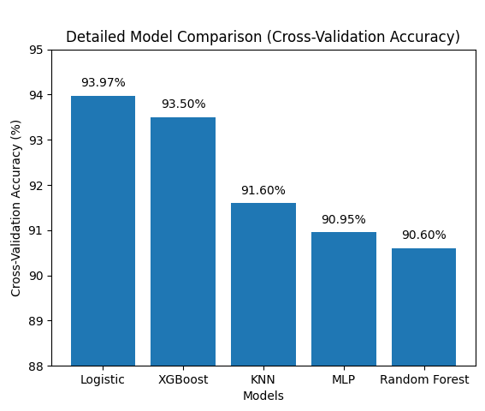
Results and Discussion
The Fig 4 shows the performance of different models for repository popularity prediction. Logistic Regression achieved the highest accuracy, followed closely by XGBoost. However, XGBoost was selected as the final model because it is more robust and performs better with structured and real-world data. Other models showed slightly lower performance due to data complexity.
Fig 4: Model comparison Graph

Slide 15
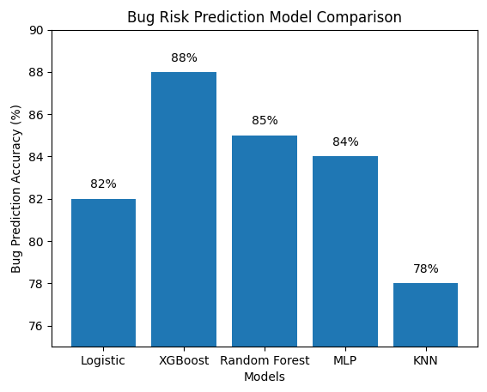
The Fig 5 shows the comparison of models for bug risk prediction. XGBoost achieved the highest accuracy of 88%, making it the best-performing model. Random Forest and MLP showed moderate results, while Logistic Regression and KNN performed lower. Based on these results, XGBoost was selected as the final model due to its higher accuracy and strong predictive capability.
Fig 5: Model comparison Graph

Slide 16
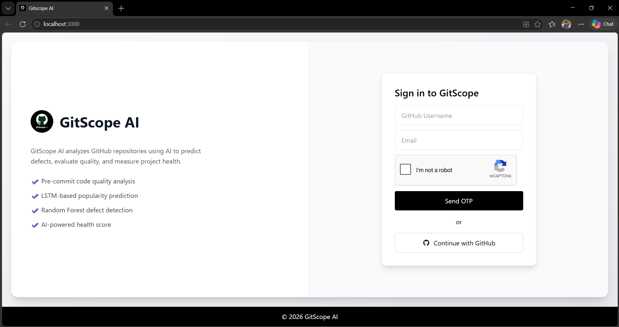
Fig 6: Login Page
The Fig 6 shows the login page of the GitScope AI system. Users can sign in by entering their GitHub username and email, followed by OTP verification or GitHub authentication. The page also highlights key features of the system, providing a simple and secure entry point for accessing repository analysis functionalities.

Slide 17
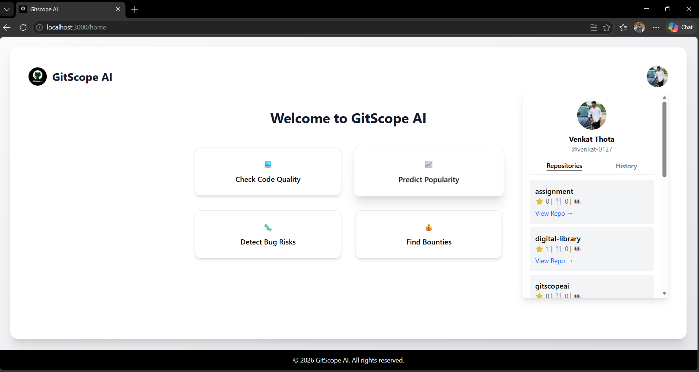
Fig 7: Main Dashboard
The Fig 7 shows the main dashboard of the GitScope AI system. It provides quick access to key modules such as code quality analysis, popularity prediction, bug risk detection, and bounty exploration. The dashboard also displays user repository details and activity, making it easy to navigate and perform different analyses from a single interface.

Slide 18
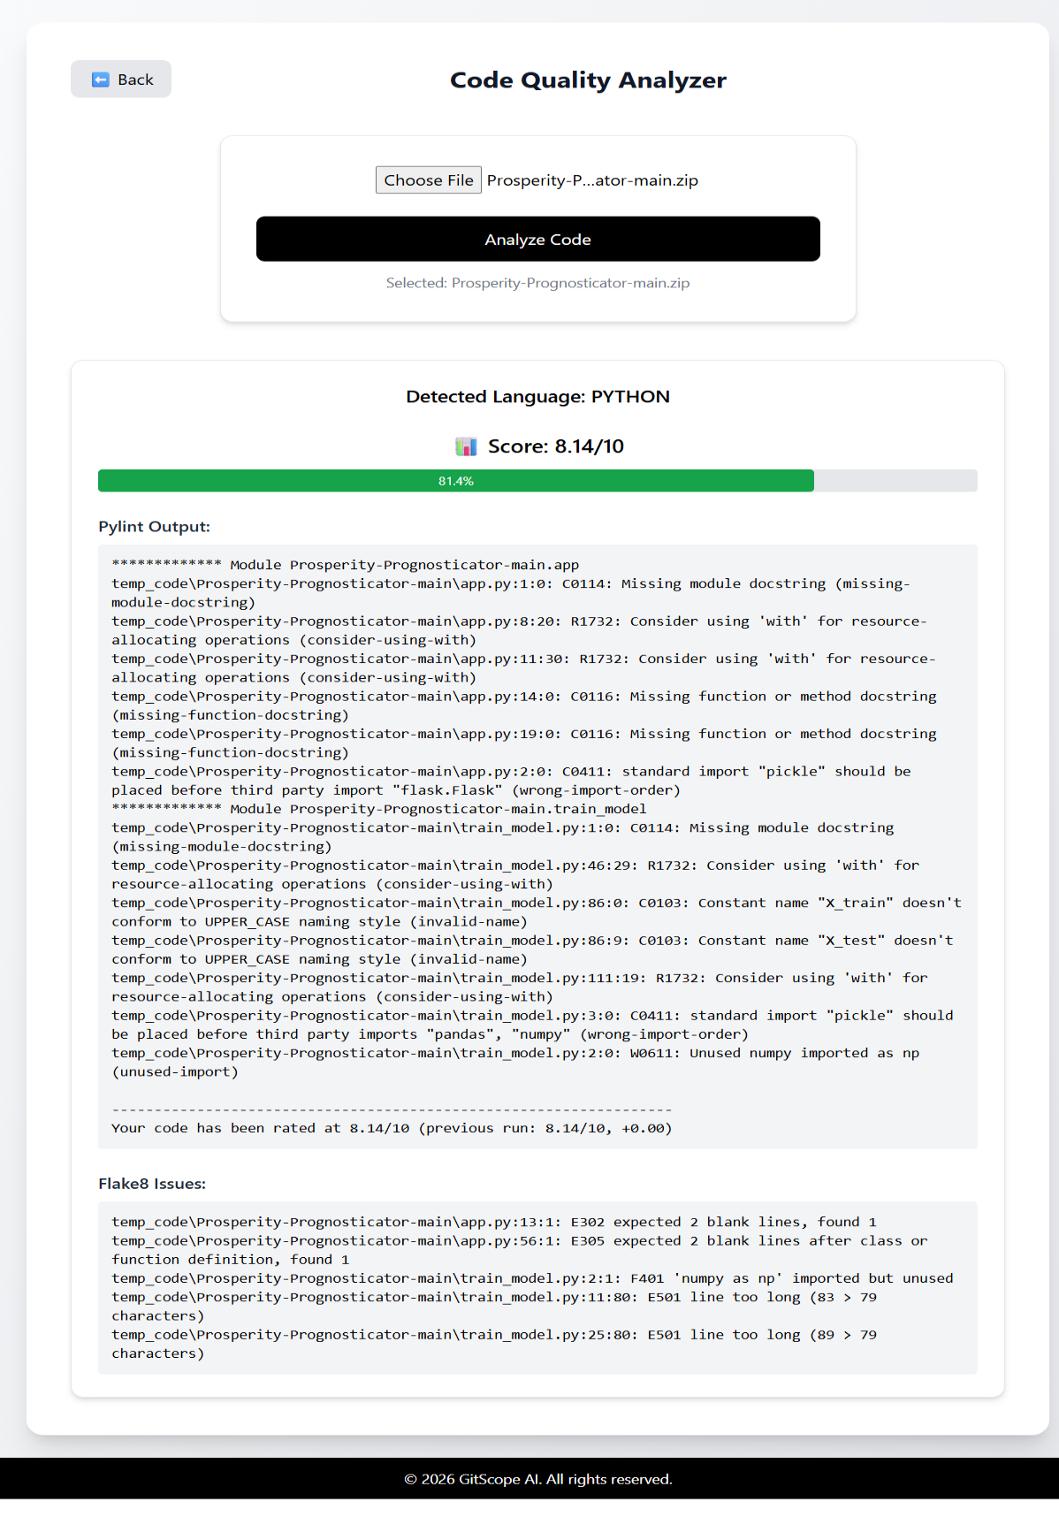
The Fig 8 analyzes the uploaded source code using static analysis techniques. It detects syntax errors, coding issues, and code quality problems using tools like Pylint. The system also provides a code quality score and detailed suggestions to improve the code. This helps developers identify issues early and maintain better coding standards.
Fig 8: Code Quality Check Module

Slide 19
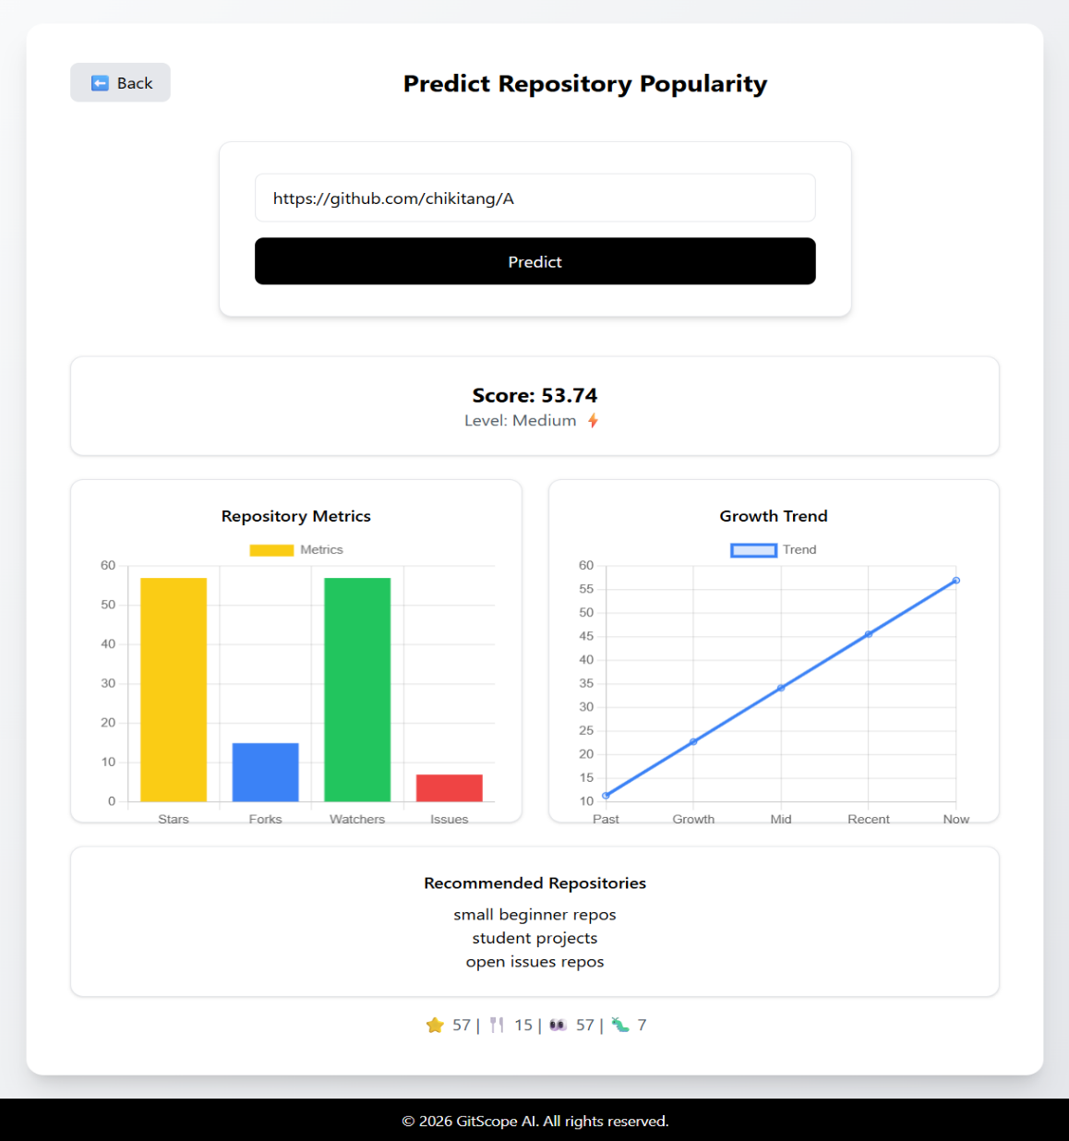
The Fig 9 predicts the popularity of a GitHub repository based on metrics such as stars, forks, watchers, and issues. It generates a popularity score and visualizes growth trends over time. The model helps users understand how active and trending a repository is. XGBoost is used for prediction due to its robust performance on structured data.
Fig 9: Popularity Prediction Module

Slide 20
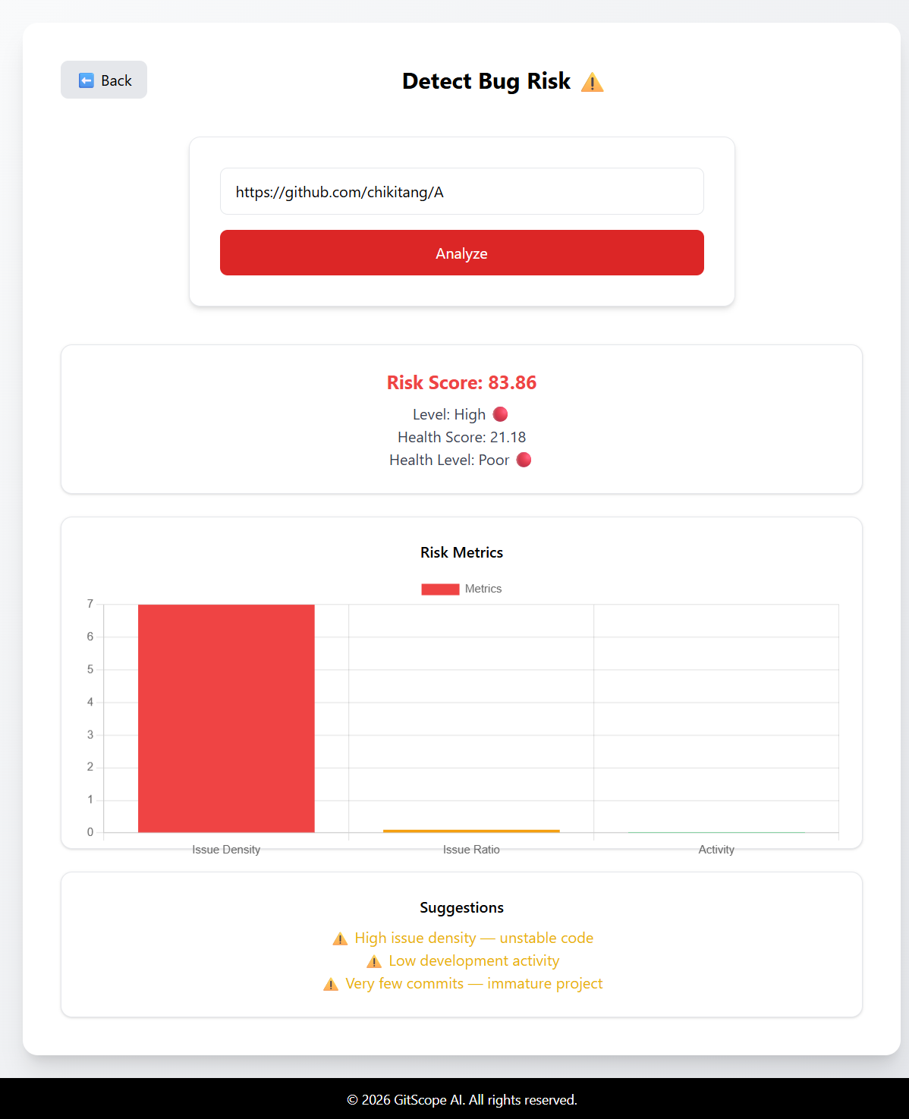
The Fig 10 analyzes a repository to estimate the risk of bugs using factors like issue density, activity, and commit patterns. It generates a risk score and categorizes the repository into levels such as low, medium, or high risk. The system also provides suggestions to improve repository health. XGBoost is used as the final model due to its higher accuracy and reliability.
Fig 10: Bug Prediction Module

Slide 21
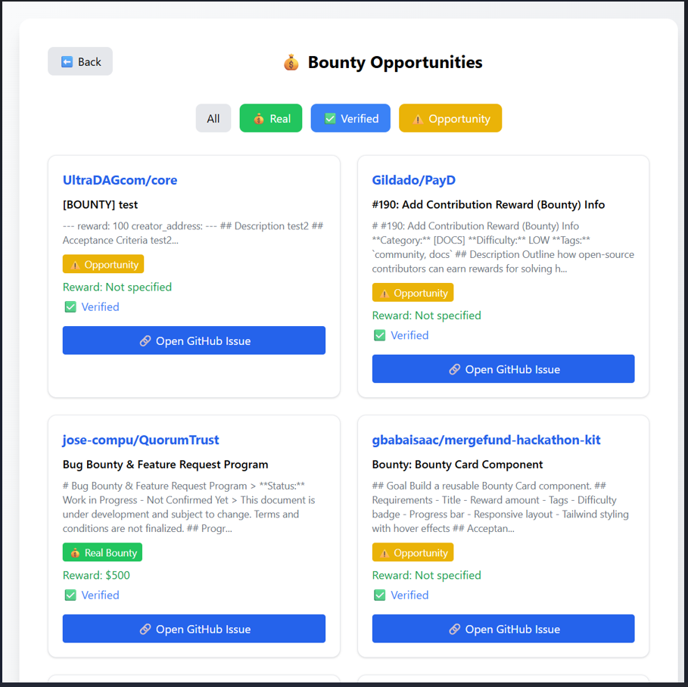
The Fig 11 identifies GitHub issues that include bounty opportunities. It helps users find tasks with rewards based on factors such as issue type, difficulty, and verification status. The system categorizes opportunities and provides direct links to GitHub issues. This supports developers in contributing to open-source projects while earning incentives.
Fig 11: Bounty Finder Module

Slide 22
CONCLUSION
This project successfully developed a machine learning-based system to evaluate GitHub repository health using multiple factors such as code quality, popularity, and defect risk. Different models were analyzed, and XGBoost was selected as the final model due to its robust performance and higher accuracy in both popularity and bug prediction tasks. The system integrates various repository metrics into a single framework, providing meaningful insights through visualization and scoring. Overall, the proposed approach helps developers and users better understand repository quality and make informed decisions.

Slide 23
Scope For Future Work
The Scope for Future work was to Extend the system to support multiple programming languages beyond Python and Java. Incorporate advanced deep learning models for improved prediction accuracy. Enhance the model by including more repository features such as pull requests and contributor behavior. Deploy the system as a scalable web application for wider accessibility.

Slide 24
Acknowledgements
We, as a team, would like to express our sincere gratitude to our guide Assistant Professor Mr. A. Rajesh, Department of Computer science and engineering, for his constant guidance, support, and motivation throughout the project. It was a great opportunity to work under his guidance and successfully complete this project.
We extend our heartfelt thanks to our respected Principal Dr. N. Satyanarayana, Lingayas Institute of Management & Technology, for providing the necessary facilities and encouragement during the course of this project.
We would like to thank Head of the department, Dr. K. Durga Bhavani, department of computer science and engineering of Lingayas Institute of Management and Technology.
We would like to thank our Chairman Mr. Rajling Gadde, Lingayas Institute of Management & Technology, for his continuous support and motivation.
We would like to extend our heartfelt gratitude and a special thanks to the Research and Development Division of Lingayas Institute for their continuous support and guidance throughout our project and supporting us in all aspects.
We express our sincere thanks to Mr. S. Swarup for their valuable help and cooperation during the project.
We express our sincere thanks to all the faculty members of Department for their valuable guidance and cooperation throughout the project.
We also thank the lab faculty for their support and assistance in completing our practical work.
We are grateful to our institution for providing library and other resources that helped us in completing this project.
Finally, we thank our friends and batchmates for their support and encouragement during the entire project period.
We also acknowledge all those who have directly or indirectly contributed to the successful completion of this project.

Slide 25
References
[1] Hajiakhoond Bidoki, N., Sukthankar, G., Keathley, H., & Garibay, I. (2018). A Cross-Repository Model for Predicting Popularity in GitHub. 2018 International Conference on Computational Science and Computational Intelligence (CSCI), 1248–1253. https://doi.org/10.1109/csci46756.2018.00241
[2] Xu, J., Yan, L., Wang, F., & Ai, J. (2020). A GitHub-Based Data Collection Method for Software Defect Prediction. 2019 6th International Conference on Dependable Systems and Their Applications (DSA), 100–108. https://doi.org/10.1109/dsa.2019.00020
[3] Caulo, M., & Scanniello, G. (2019). On the Use of Commit Messages to Support the Creation of Datasets for Fault Prediction: An Empirical Assessment. 2019 45th Euromicro Conference on Software Engineering and Advanced Applications (SEAA), 193–198. https://doi.org/10.1109/seaa.2019.00039
[4] Shen, Y., Hu, S., Cai, S., & Chen, M. (2022). Software Defect Prediction based on Bayesian Optimization Random Forest. 2022 9th International Conference on Dependable Systems and Their Applications (DSA). https://doi.org/10.1109/dsa56465.2022.00149
[5] Zhou, J., Wang, S., Bezemer, C.-P., Zou, Y., & Hassan, A. E. (2021). Studying the Association Between Bountysource Bounties and the Issue-Addressing Likelihood of GitHub Issue Reports. IEEE Transactions on Software Engineering, 47(12), 2919–2933. https://doi.org/10.1109/tse.2020.2974469

Slide 26
Thank You

